Slide 1

Identifying Neighbourhoods of Toronto to open a Coffee Shop in
Coursera Project
2019

Slide 2
“I have measured out my life with coffee spoons” - T.S. Eliot
Coffee shops are a very lucrative venue to open across the world, providing the public with a very desired resource
Many new business owners tap into the coffee shop market in order to establish themselves and carve their own piece of the consumer industry
But there are a lot of coffee shops in Toronto, so there needs to be a way to identify neighbourhoods such that
- There are venues around the neighbourhood conducive to opening a coffee shop
- There is not already enough coffee shops in the neighbourhood to oversaturate the market and make it difficult for a new owner to break in

Slide 3
Data Acquisition and Cleaning
- Toronto neighbourhood data has been scraped from: https://en.wikipedia.org/wiki/List_of_postal_codes_of_Canada:_M
Geospatial data for these neighbourhoods was scraped from: http://cocl.us/Geospatial_data
The FourSquare API was used for venue and neighbourhood data, the website of which is: https://developer.foursquare.com/
This data was compiled into two main dataframes, one of which consisted of the longitude, latitude, neighbourhoods and boroughs while the other has neighbourhoods relevant to their venues contained within. The dataframes had the dimension (103, 5) and (100,275)) respectively.

Slide 4
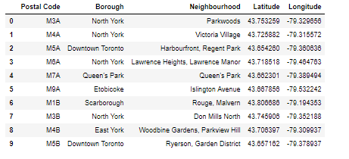
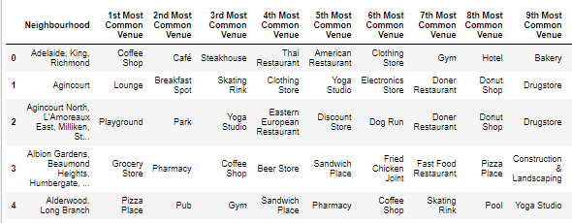
Snapshot of the data in dataframes
Coordinate data of Neighbourhoods in Toronto, CA
Comparison of Venues and Neighbourhoods in Toronto, CA

Slide 5
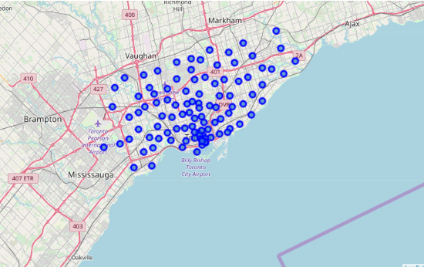
Visualisation of Toronto Neighbourhoods

Slide 6
Comparison of correlation of other venues to coffee shops
Positive Correlation (as these increase in frequency, so do coffee shops)
Negative Correlation (as these increase in frequency, coffee shops decrease)
Coffee shop 1.000
Korean Restaurant 0.560
Nightclub 0.256
Restaurant 0.245
Diner 0.235
Theatre 0.230
French Restaurant 0.212
Seafood Restaurant 0.211
Salad Place 0.208
Metro Station 0.185
Park -0.270
Bus Line -0.199
Playground -0.155
Trail -0.152
Home Service -0.149
Athletics and Sports -0.124
Shopping Mall -0.121
Baseball Field -0.120
Construction & Landscaping -0.120
Fast Food Restaurant -0.119

Slide 7

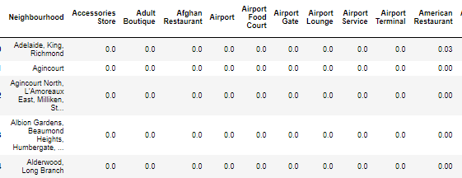
Using KNN we create a neighbourhood then calculate the distance between this ideal neighbourhood and those already existing in Toronto
First, take the dummy neighbourhood made of the correlations
Then compare to the mean frequencies of venues in each neighbourhood to find closest matches

Slide 8
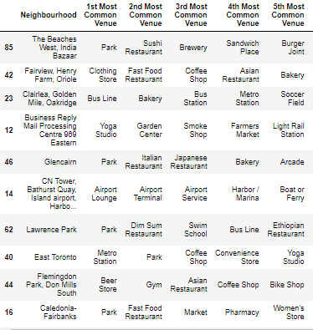
Ten neighbourhoods likely to provide success to a new coffee shop based on low competition and desirable co-venues

Slide 9
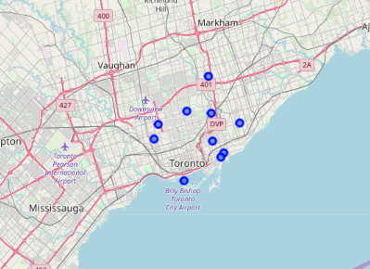
Visualisation of locations of the ten chosen neighbourhoods

Slide 10
Conclusion and Future Directions
- Through using nearest neighbour and distance measures 10 neighbourhoods were identified where coffee shops could be successful based on their co-venues and their competition in the market
This is a useful model as it could be applied to other cities or different types of venue within Toronto, such as restaurants, with little effort
The model could be improved with more data to add a measure of classification rather than just clustering and distance
Financial data about success of cafes in neighbourhoods could be applied
Data from similar towns to Toronto could provide a more general model
Census data on populations of the neighbourhoods would enrich the dataset and give sociological reasoning to whether or not a coffee shop will be successful

